Slide 1

Investor Presentation May 2026

Slide 2

Privacy:
This presentation is confidential and falls under patent law:

Slide 3

Agenda
The problem
The human spine
Intervertebral Disc
Four stages of disc disease
PAINFUL DAMAGED DISC SYDROME
CAUSE OF PAIN
STATISTICS
CURRENT THERAPIES
MEDICAL MERRY-GO-ROUND
The Solution

Slide 4
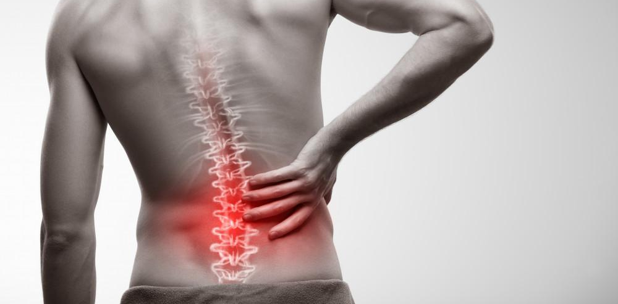
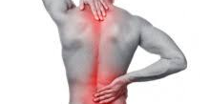
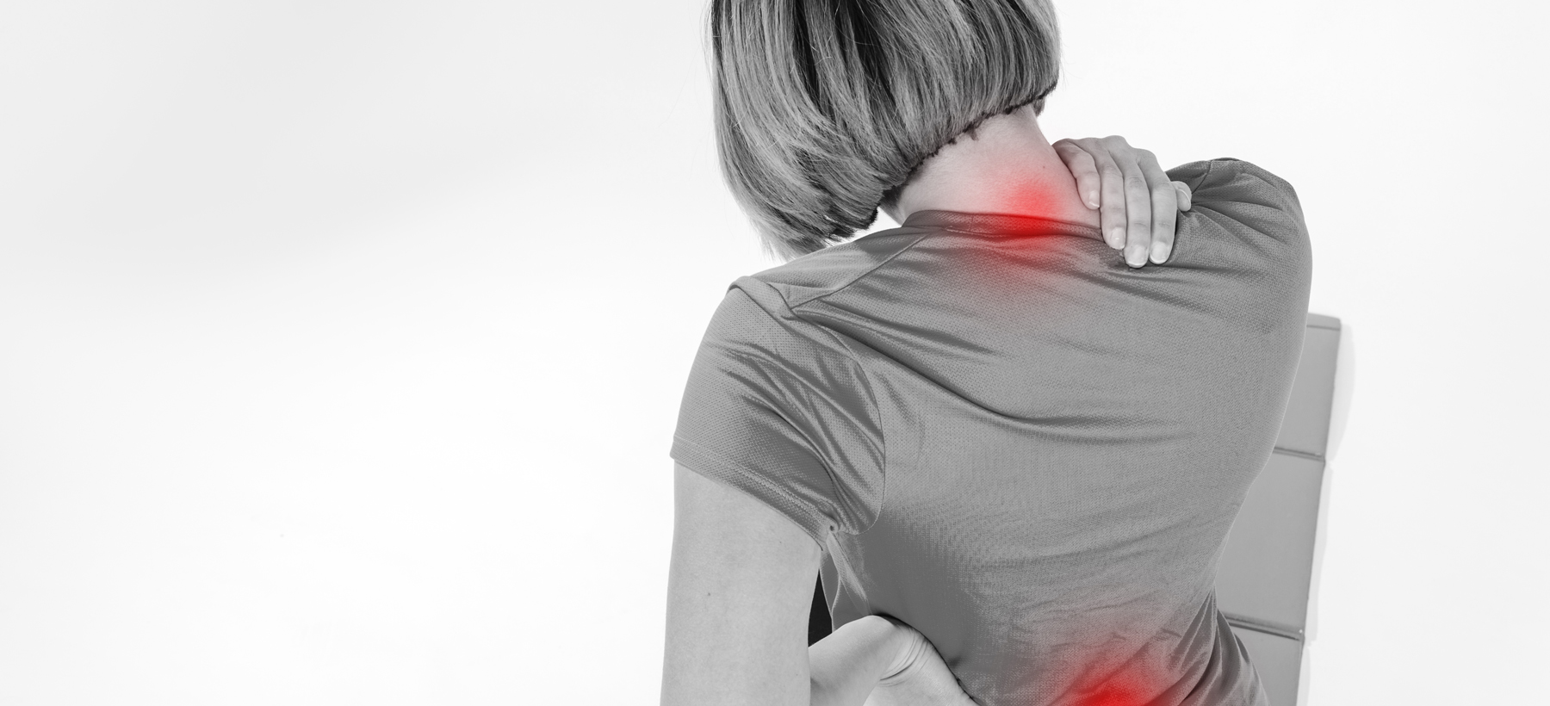
The problem
Treatment/Time Resistant Pain Due to Damaged Disc Syndrome

Slide 5
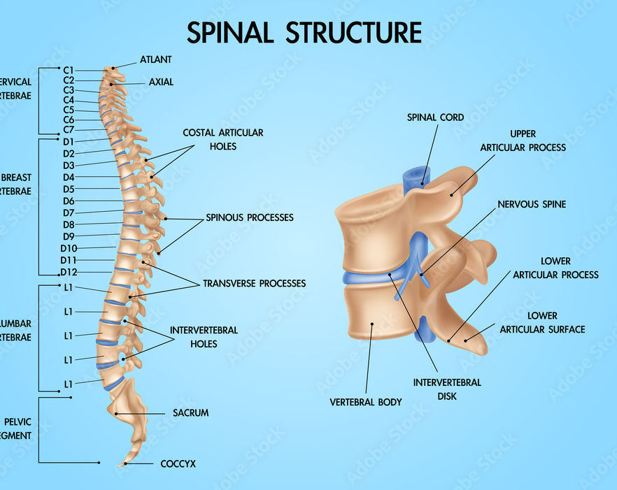
The Human Spine
The human spine is comprised of 33 vertebrae, an intravertebral disc exist between spinal vertebrae.

Slide 6
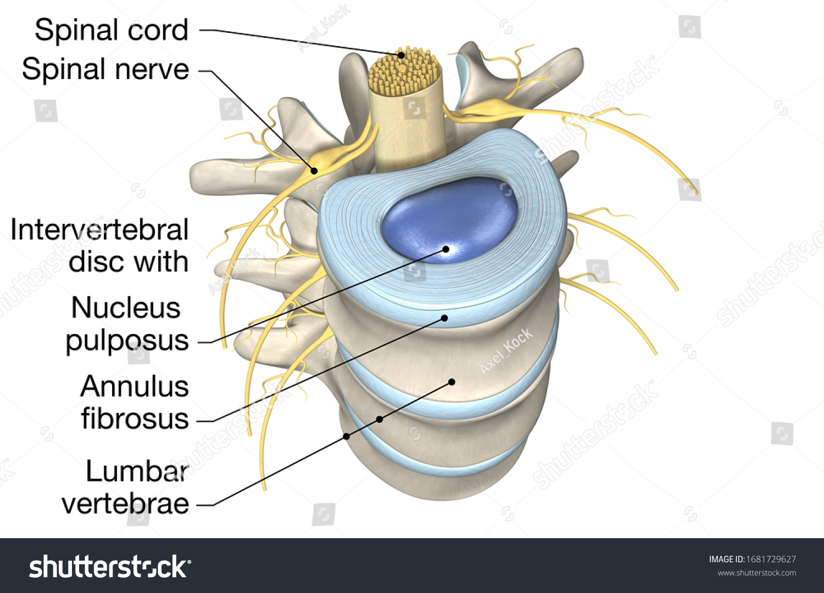
Intervertebral Disc
1. Outer layer called annulus comprised of an outer layer
2. Nucleus polyposis-inner, jellylike portion of the disc.

Slide 7
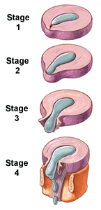
Four stages of Disc Disease
1. Bulging Disc
2. Protrusion
3. Herniation/extrusion
4. Sequestration

Slide 8
Painful Damaged Disc Syndrome (PDDS)
Giving rise to spinal pain and symptoms with or without radiculopathy. Most common causes:
Used to describe the whole genre of disc pathology, including but not limited to disc:
Degeneration/wear and tea
Trauma
Bulge
Prolapse
Protrusion
Herniation/extrusion

Slide 9
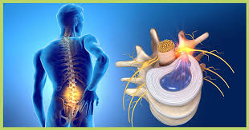
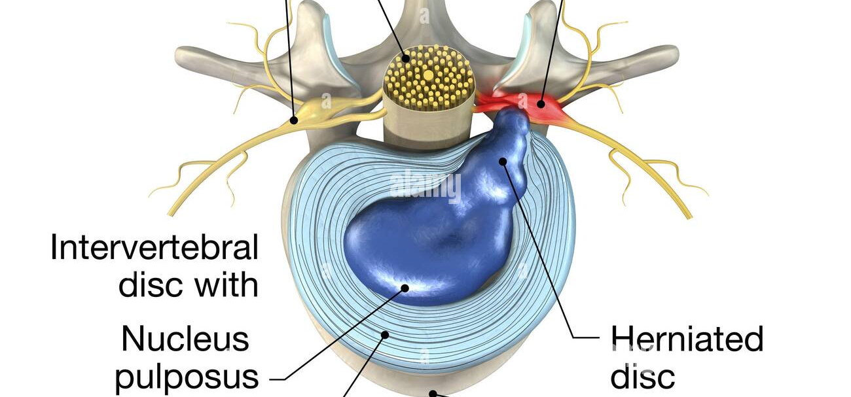
What causes the pain?

Slide 10
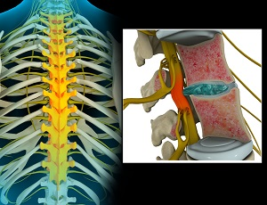
Pathophysiology of disc pain
Pain thought to be originating from a combination of:
Thoracic Nerve Compression
Mechanical compression of spinal nerve root of the disc
Local increase of inflammatory substances around the spinal nerve root
See references 1-5

Slide 11
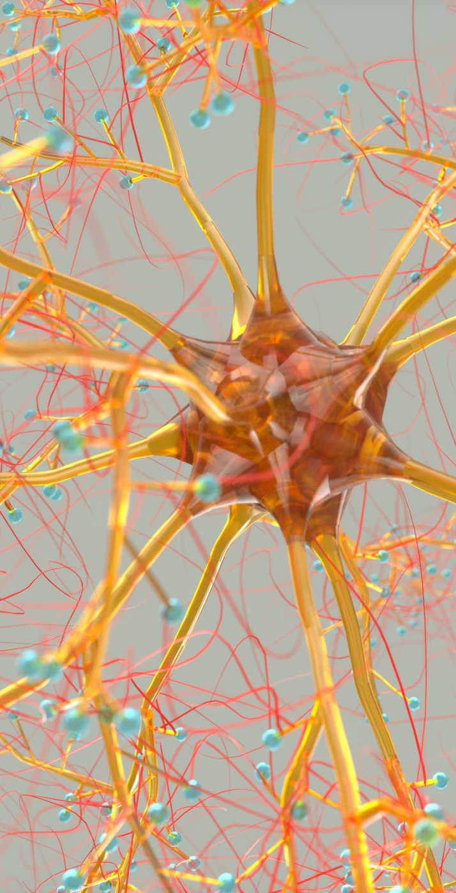
inflammation
The role of inflammatory signaling in producing nerve pain in lumbar disc herniation has been well – established.

Slide 12
NCBI (NATIONAL CENTER FOR BIOTECHNOLOGY INFORMATION P
INCIDENCE OF HERNIATED DISC IS ABOUT 5-20 CASES PER 1000 ADULTS ANNUALLY
3-6 MILLLION AMERICANS ANNUALLY!

Slide 13
CLEVLAND CLINIC STATES THAT UP TO 2 % OF PEOPLE GET A HERNIATED DISC EVERY YEAR

Slide 14
403,000,000
403 MILLION (5.5 %) INDIVIDUALS WORLDWIDE WERE FOUND TO HAVE SYMPTOMIC DISC DEGENERATION/DISEASE

Slide 15
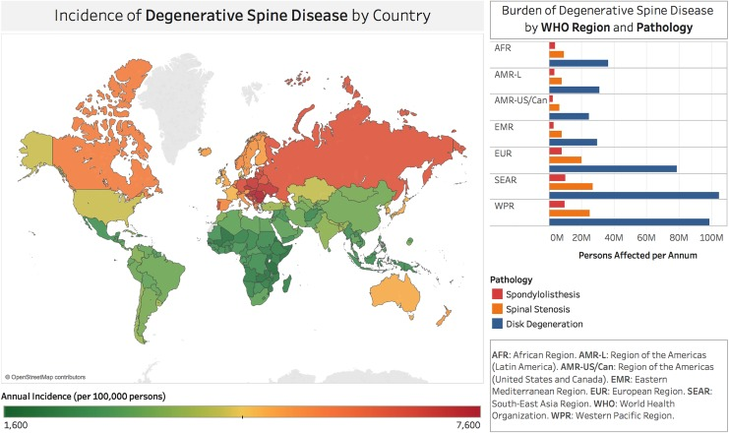

Slide 16
CERVICAL PAIN IS THE FOURTH LEADING CAUSE OF DISABILITY IN THE UNITED STATES

Slide 17
SYMPTOMATIC HERNIATIONS ARE SHORT LIVED, AND STUDIES HAVE SHOWN THAT 85-90% OF THE CASES WILL RESOLVE WITHIN 6-12 WEEKS WITH OR WITHOUT INTERVENTION(10).

Slide 18

WELCOME TO THE PAINFUL DISC DISEASE MEDICAL
MERRY-GO-ROUND
NO TREATMENT
PHYSICAL THERAPY
CHIROPRATIC
MEDICATION
DISABILITY
ACUPUNCTURE
MASSAGE
DECOMPRESSION
BED REST

Slide 19
CURRENT OPTIONS FOR PDDS
SPINAL EPIDURAL INJECTIONS
SPINAL FUSION SURGERY

Slide 20
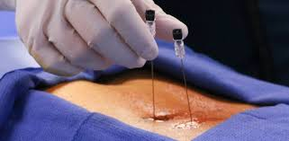
EFFECTIVENESS OF SPINAL EPIDURAL INJECTIONS
50 % OF THE TIME, 50 % OF THE PEOPLE FEEL 50 % BETTER FOR 1-3 MONTHS
IT IS IMPORTANT TO UNDERSTAND THAT EPIDURAL SPINAL INJECTIONS ARE NOT INTENDED TO CURE BACK PAIN, ONLY TO PROVIDE TEMPORARY RELIEF

Slide 21
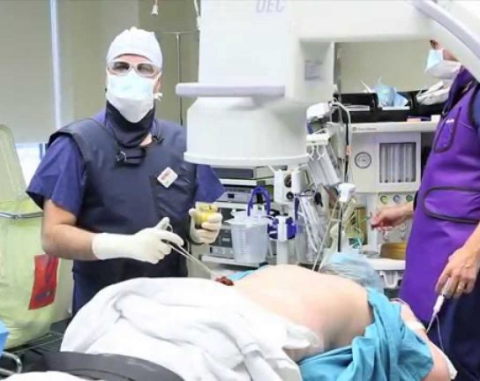
SPINAL EPIDURAL INJECTIONS ARE THE MOST COMMONLY PERFORMED PAIN MANAGEMENT PROCEDURE IN THE UNITED STATES!
EACH EPIDURAL SPINAL INJECTION INCREASES FRACTURE RISK BY 31%

Slide 22
FDA/ema
APRIL 2014, FDA ISSUED A REQUIRMENT THAT ALL INJECTABLE CORTICOSTERIODS PRODUCT LABELS CARRY A WARNING STATING THAT “SERIOUS NEROLOGICAL EVENTS, SOME REPORTING IN DEATH, HAVE BEEN REPORTED WITH EPIDURAL INJECTIONS OF CORTICOSTERIODS. THE SAFETY AND EFFECTIVENESS OF Epidural ADMINISTRATION OF CORTICORSTERIODS HAVE NOT BEEN ESTABLISEHD AND STERIODS ARE NOT APPROVED FOR THIS USE ACCORDING TO THE FEDERAL FOOD AND DRUG ADMINISTRATION AND EUROPEAN MEDICINES AGENCY

Slide 23
The total number of epidurals
Approximately 9-11 Million/ per year in USA
Approximately 2.2 Million in Medicare population

Slide 24
Spinal Epidural cost in USA
23 Billion in 2022
230 percent increase since 2002

Slide 25
medicare total expenditure
Medicare total expenditure for spinal epidural injections for treatment of chronic back pain:
  $175,000,000 in the year 2007
  $723,981,594-in the year 2009
  $829,987,636-in the year 2018

Slide 26
FDA
The “safety and effectiveness of epidural administration of corticosteroids are NOT approved for its use. “

Slide 27
surgery for disc herniation
Discectomies
Spinal Fusion

Slide 28
Cost of surgery
ACCORDING TO 2023 DATA FROM U.S. NEWS &
WORLD REPORT
AVERAGE COST OF THE FOUR MOST COMMON
SPINAL SURGERIES IN THE USA:
DISKECTOMY: Between 15,000 & 35,000.00$
LAMINECTOMY: From 50,000 to 90,000.00$
SPINAL FUSION SURGERY: From 80,000 to 150,000 $ for patients with out insurance
ARTIFICAL LUMBAR DISK SURGERY: from 20,000 to 70,000$

Slide 29
Lumbar discectomies performed each year in us
Approximately 480,000
Approximately 132,000 anterior cervical discectomies and fusions

Slide 30
recurrent post discectomy lumbar disc herniation
Recurrent herniation of the nucleus propolis (HNP)and subsequent disc degeneration is a common problem, with reported rates between 2 and 25 percent.

Slide 31
lumbar discectomy associated with higher rates of lumbar fusion
We found that people who had a lumbar discectomy procedure were 2.97% more likely to undergo a lumbar fusion.

Slide 32
Diabetic patients
Diabetic patients requiring lumbar discectomy; 28 percent required re-operation.

Slide 33
spinal fusion
IN THE us annually
Approximately 210,000 lumbar fusions
Approximately 24,000 thoracic fusions
Approximately 157,000 cervical fusions

Slide 34
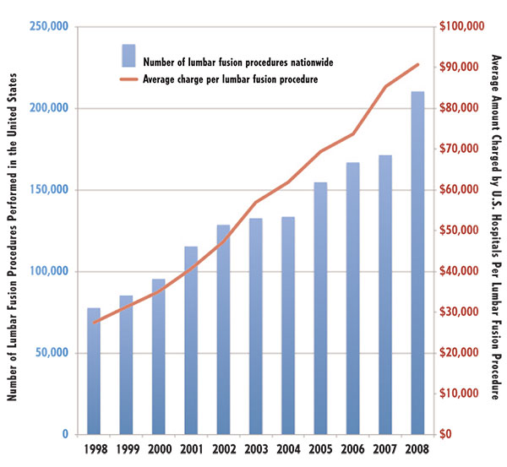
Lumbar Fusions nationwide

Slide 35
PAIN
Between 5-30% of patients having spinal fusion surgery report on-going pain

Slide 36


The solution

Slide 37
Introducing the World’s First Compound Exclusively Formulated to Address the Chronic Pain of Disc Disease……

Slide 38

US Patents Numbers US11,951,084 B1
US 2024/0358660
PCT application is filing in China, Germany, India, Japan, Australia, Israel, Canada and the United States
Magnecine is a trademark name
TM

Slide 39
magnecine
A compound formulation by Progressive Health Partners, is a combination of Magnesium Chloride and Colchicine formulated for intravenous use in the treatment of pain related to treatment resistant intervertebral disc disease

Slide 40
MAGNECINE
Finally, a non-addictive, non-steroidal approach to permanently eliminating pain due to treatment resistance disc disease for most patients.
An option to opioids!

Slide 41

Progressive Health Partners has invented a cost effective compound to treat the unmet medical need of chronic pain due to disc disease.

Slide 42
REFERENCES
1.
1. Bogduk,N. On the definitions and physiology of back pain, referred pain and radicular pain. Pain 2009 Dec 15;147(1-3):17-19.
2. Brisby,H. Pathology and possible mechanisms of nervous system response to disc herniation. J Bone Joint Surg Am 2006 April;68-71.
3. Marshall,L. Trethewie,A. Chemical Irritation of Nerve-Root in disc prolapse. Lancent Aug 1973;2(7824):320.
4. McCarron,RF. Wimpee,MW. Hudkins,PG. The inflammatory effect of the nucleus pulposis. A possible element in the pathogenosis of low back pain. Spine 1987;12 (8):760-764.
5. Igarashi,T. Kikuchi,S. Shubayer,V. Myers,RR. Exogenous tumor necrosis factor – alpha mimics nucleus pulposus-induced neuropathy. 2000 Dec Spine 25: (23):2975 -2980.
6. Disc Herniation – StatPearls – NCBI
7. Fjeid,OR. Grovle,L. Helgeland,J. Smastuen,MC. Solberg,TK, Zwart,JA, Grotle,M. Complications, reoperations, readmissions, and length of hospital stay in 34,639 surgical cases of lumbar dis herniation. Bone Joint J. April 2019;101-B(4);470-477.
8. Herniated Disc:What It Is, Diagnosis, Treatment, and Outlook HTTPS://MYCLEVELANDCLINIC.ORG/HEATH/DISEASES/12768.
9. Vijay,M. Ravindra,MD,MSPH. Steven S.Senglaub,MS, Abbas Rattani,Mbe,Micheal C. Dewan, MD,MSCI, Roger Hartl,MD, Erica Bisson,MD, MPH. Kee B. Park,MD, and Mark G. Shrime,MD,MPH, PhD. Degenerative Lumbar Spine Disease: Estimating Global Incidence and Worldwide Volume. Aospine journals.sagepub.com/home/gsi.
10. Schoenfeld,AJ. Weiner,BK. Treatment of Lumbar Disc Herniation:Evidenced – based Weiner practice. Int. J Gen Med 2010 July21:3:209-214.
11

Slide 43
REFERENCES
11. Cohen,SP. Epidemiology, Diagnosis, and Treatment of Neck Pain . Mayo Clin Proc. 2015:Feb,09;(2):284-299.
12. Manchikanti,L. Soin,A. Mann,DP. Et al. Comparative Analysis of Utilization of Epidural Procedures in Managing Chronic Pain in The Medicare Population:Pre and Post Affordable Care Act. Spine 2019,;(44):220-232.
13. Mandel,S, Schilling,J. Peterson,E. Rao,DS. Sanders,W. A Retrospective Analysis of Vertebral Body Fractures Following Epidural Steroid Injections. J Bone Joint Surgery 2013;(95) 961-964.
14. Gunner,BJ. Anderson,MD. Epidural Glucocorticoal Injections in Oatients with Lumbar Spinal Stenosis. N. Engl J. Med July 3,2014;371:75-76
15. Market data Enterprizses, Inc. Tampa Florida The Economic Times. Epidural Shots, A sreroid push, a 300 million pain market in America.
16. Laxmaiah,M. Vidyasagar,P. Amal,S. Mahendia,S. Kaye,A. Hirsch,J. Declining Utilization and Inflation – Adjusted Expenditures for Epidural Procedures in Chronic Spinal Pain in Medicare Population. Pain Physicians 2021 Jan;24(1):1-15.
17.Racgosin,JA. Seymour,SM. Cascio,L. Gill,R. Serious Nerological Events After Epidural Glucocorticoid Injection – the FDAs Risk Assessment. N Eng J Med. 2015;373:2299-2301.
18. Neurosurgery.inmedpub.com
19. Comron,S. Fein,A. Cazzulino,A. Lehman,R. Phillilips,F. Howard,S. Riew,D. Trends In Resource Utilization and Rate of Cervical disc arthroplasty and anterior Cervical Discectomy and Fusion Thruout the USA,2006-2013. Spine J. 2018Jan;1896)1022-1029.
20. Ambrossi,GI. McGirt,MJ. Sciubba,DM. Witham,TF. Wolinsky,J. GokaslanZL. Long,DM. Recurrent Lumbar Disc Herniation After a Single Level Lumbar discectomy; Incidenc and Health Care Cost Analysis. Neurosurgery.2009;65:574-578.
21. Clinical Orthop Related Res. 2017 Nov;475(11);2752-2762
22. Spine J.2019March19(3):487-492.
23. Ralph, J. Mobbs,D. Raymond L. Newcombe,Nadana,K. Chandran,MS. Lumbar discectomy and the Diabetic Patient:Incidince and Outcome. Jouranal of Calinical Neuroscience Volume 8,Issuel, Jan2001;10-13.
24. Rajaee,S. Bae,H. KanimL,Delamarter,R. Spinal Fusion In US Spine 2012;37(1):67-76.

Slide 44
Team
Dr Mark Bartiss
Medical Director
Dianne Dalton, MPA
President
Dr Daniel Bies
Chief Scientific Officer

